Slide 1

OTC DRUG RECOMMENDATION CHATBOT
Supervisor: Sir Khawaja Mohiuddin
Team Members:
Esa Anjum 1712145
Shayan Ur Rehman Siddiqui 1712172

Slide 2
Introduction
Working:
A web application will be developed that has a chatbot that uses decision tree based algorithm to ask user a series of questions after he/she has initiated a conversation about his/her problem. The chatbot will look for meaningful data in conversations using Natural Language Processing.
The Chatbot will narrow down the problem to become certain of the user’s health issue, known allergies, current medications and then recommend the best suitable OTC medicines along with all important information such as dosage, active ingredient, uses etc.
Medication errors will be reduced as it will check drug-drug interaction, underlying conditions and current medication of the user.

Slide 3
FYP-I SCOPE
Actor
Patient
Features
Basic UI
Chatbot conversation
Symptoms checking
Illness Severity/Chronicity detection
Disease identification
Drug Interaction checking
Medical condition checking
Common Side effects
Drug name and reliable brand name recommendation.
Outputs
Web Application with basic UI, Chatbot

Slide 4
FYP-II SCOPE
Actor
Patient
Admin
Features
Complete UI
SignIn-SignOut
My Medications, My Medical Conditions
Pill Schedule Generation
Admin Support (complaint processing)
Drug-Drug Interaction checker
Drugs Search w.r.t brand name, drug name, symptoms and side effects
Outputs
Web Application with complete frontend and backend including all the features

Slide 5
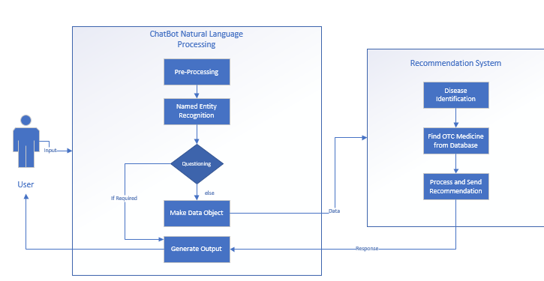
Requirements Analysis Artifacts (FYP-1)
1. Project Block Diagram

Slide 6
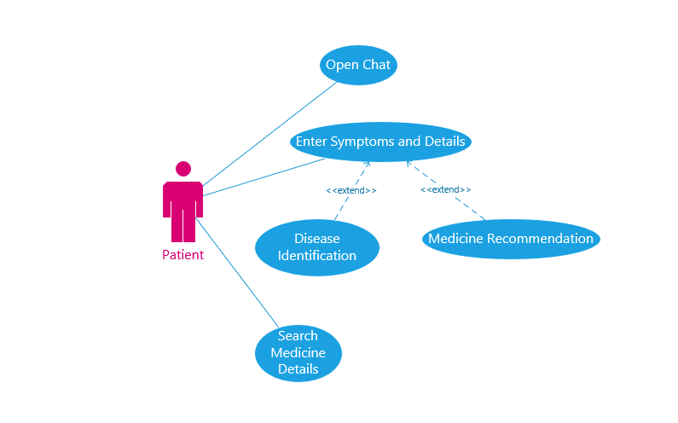
2. Use Case Diagram

Slide 7
3. Use Cases (text)
Name: Open Chat
Goal: This Use Case initiates Conversation between the User and the Chatbot.
Actor: User
Pre-conditions: ----
Triggers: When User enters the chat room.
Basic Course of Events:
Alternate Path: N/A
Post-Condition: User will be asked to describe symptoms.
Author: Shayan-Ur-Rehman Siddiqui Date: 10/30/20
Exceptions:
Back-End Server is Offline.
User Action | System Response
User enters the chat room. | Chatbot greets.
User replies. | Asks to describe symptoms.

Slide 8
Name: Enter Symptoms and Details
Goal: This Use Case lets the user to get his/her disease identified and get a medicine recommendation.
Actor: User
Pre-conditions:
The greeting between chatbot and user is done.
Triggers: When User replies to the greetings from chatbot.
Basic Course of Events:
User Action | System Response
User describes symptoms. | Chatbot stores symptoms, asks relevant questions(one by one).
User replies to different questions. | Finds disease that matches user’s details, finds appropriate medicine, then recommends it.

Slide 9
Alternate Path 1
User Action | System Response
1A1) If User enters irrelevant information. | Chatbot asks user to reply again.
1A2) User replies.
:
Alternate Path 2A:
User Action | System Response
2A1) If User enters symptoms that are severe or do not match any disease. | System recommends medicine to treat individual symptoms and a visit to doctor.
Alternate Path 2B:
User Action | System Response
2B1) If User enters symptoms and details that do not match any appropriate medicine. | System notifies and recommends a visit to doctor.
Post-Condition: System successfully identifies disease and recommends medicine.
Author: Esa Anjum Date: 10/30/20
Exceptions:
Back-End Server is Offline.

Slide 10
Name: Search Medicine Details
Goal: This Use Case lets the user to find details about specific medicine by entering any one attribute related to drug(s) such as interactions, contraindications, brand-name, etc.
Actor: User
Pre-conditions:
User is using the website’s page dedicated to details about drugs.
Triggers: When the User goes to the page about drugs’ details.
Basic Course of Events:
Alternate Path:
Post-Condition: System returns drug(s)’ information.
Author: Shayan-Ur-Rehman Siddiqui Date: 10/30/20
Exceptions:
Back-End Server is Offline.
User Action | System Response
User enters details in different fields available and presses enter. | System searches for drugs related to that information and returns relevant drug(s)’ details.
User Action | System Response
If User enters irrelevant information. | System returns no results.

Slide 11
4. System Sequence Diagrams
OPEN CHAT

Slide 12
4. System Sequence Diagrams
SEARCH DRUGS

Slide 13
4. System Sequence Diagrams
DISEASE IDENTIFICATION AND MEDICINE RECOMMEDNATION

Slide 14
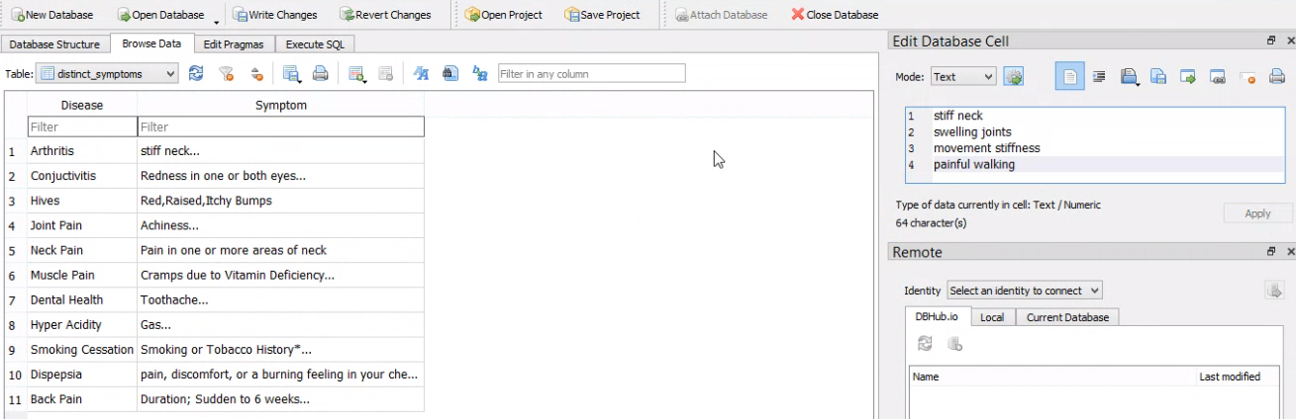
Design Artifacts(FYP-I)

Slide 15
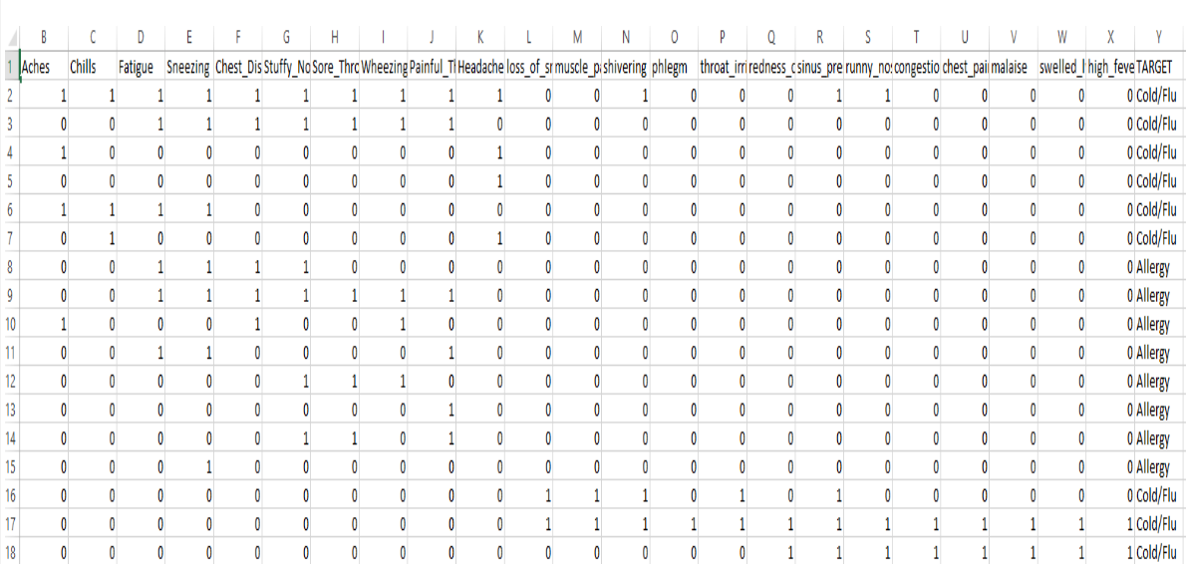
Design Artifacts(FYP-I)

Slide 16
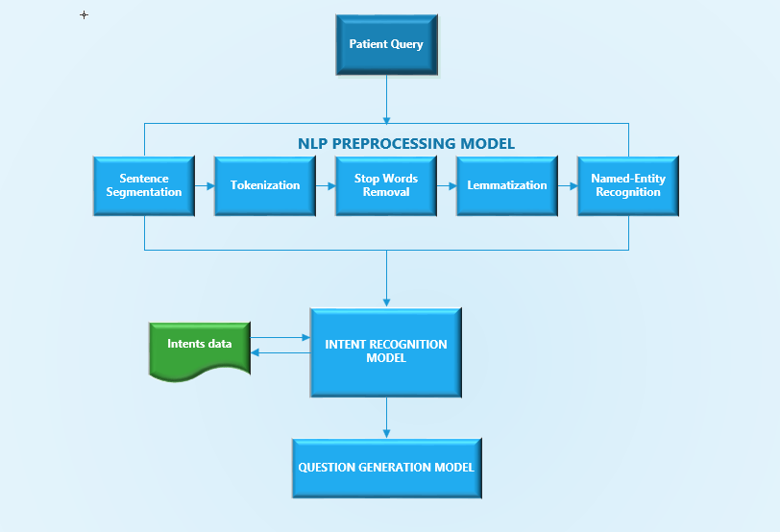
Design Artifacts(FYP-I)

Slide 17
Evaluation Artifacts(FYP-I)
TEST CASE
Test Case # 1
Test Case ID | Test Case Name | Test Case Summary | Test Case Steps | Expected Result
01 | OPEN CHAT | Verifies if the chatbot greets as programmed and asks user to describe symptoms | User enter chat room | Chatbot greets User.
 |  |  | User replies to the chatbot’s greeting | Chatbot starts asking relevant questions

Slide 18
Evaluation Artifacts(FYP-I)
Test Case # 2
Test Case ID | Test Case Name | Test Case Summary | Test Case Steps | Expected Result
02 | SEARCH MEDICINE | In the search feature user will enter a keyword to be searched. It will search the keyword in the medicine database. | Enter correct keyword (present in database) | Searched record will be displayed
 |  |  | Enter incorrect keyword (not present in database) | Display a message “No Record Found.”

Slide 19
Evaluation Artifacts(FYP-I)
Test Case # 3
Test Case ID | Test Case Name | Test Case Summary | Test Case Steps | Expected Result
03 | ENTER SYMPTOMS | This test case verifies whether the chatbot is able to understand user’s query and asks relevant questions | User mentions symptoms he/she is experiencing. | Chatbot asks questions to extract details about symptoms as described by the user.
 |  |  | User enters invalid text | Chatbot request user to precisely describe symptoms once again
 |  |  | User describe symptoms being severe | Chatbot should advise caution after the conversation ends
 |  |  | User give valid answers to the Chatbot questions | Chatbot should be able identify disease and recommend suitable medicine

Slide 20
FYP-I Features Implemented
Features
1. Dataset
2. Symptoms checking
3. Illness Severity/Chronicity detection
4. Disease identification via Decision Tree
5. Medical Condition extraction (only code)
6. Current Medication extraction (only code)
Basic UI
API Integration
Medicine Database (for quering)
FYP-I Features Remaining

Slide 21
THANK YOU

